Slide 1


ENGLISH LEVEL B1 - II
Lesson 03
TALKING ABOUT YOUR HOLIDAY
Notes:
Teacher’s Notes:
Explain the lesson goal: learning words and sentences related to hospitals.
Ask students: Have you ever been to a hospital? Why?

Slide 2

01
Students will be able to discuss and ask questions about their travel experiences
ENGLISH LEVEL B1 - II

Slide 3
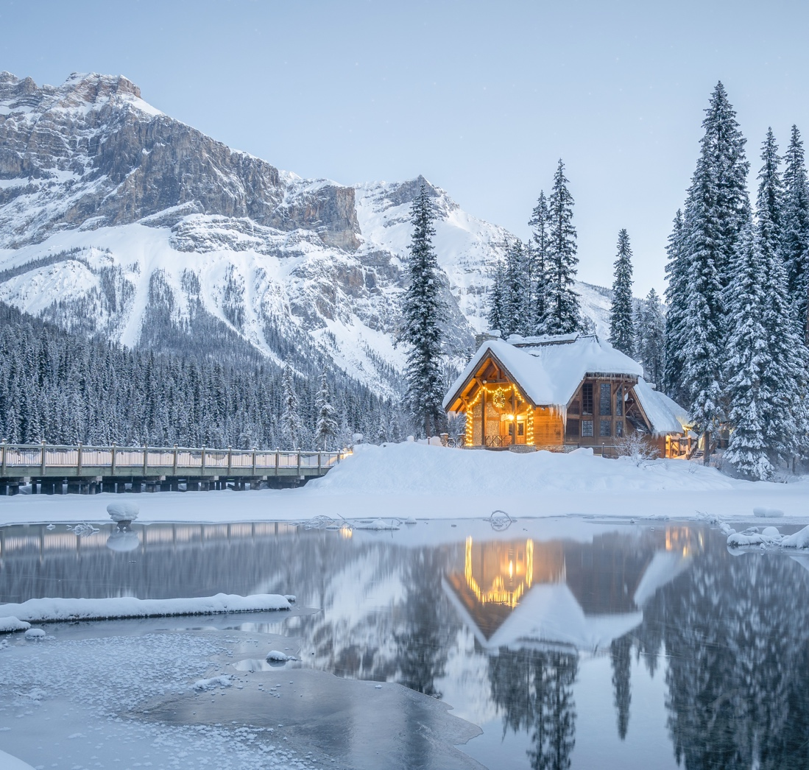
TALKING ABOUT YOUR HOLIDAY
LET’S TALK ABOUT TRAVELING!
Look at the picture and answer the questions
1
Where do you like to go on holiday?
2
Have you ever been on a trip by train?
3
What is your dream travel destination?
4
What things do you usually bring on a trip?
5
Do you prefer the beach, mountains, or cities? Why?

Slide 4

TALKING ABOUT YOUR HOLIDAY
Travel Vocabulary in Context
Vocabulary Words:
Ski resort, hike, passengers, scenery, holiday, journey, stay
Exercise: Complete the following sentences with the correct vocabulary words:
The __________ was long, but the beautiful views made it enjoyable.
We stayed in a small cabin near the __________.
I love to go on a __________ through the mountains.
The __________ on the train were excited for their vacation.
Our __________ in the hotel included breakfast and dinner.

Slide 5
TALKING ABOUT YOUR HOLIDAY
TRAVEL WORDS – MATCH THEM!
Instructions:
Match the travel words in Column A with their correct meanings in Column B.
Column A (Travel Word) | Column B (Meaning)
1. Bag | A paper or digital pass to get on a plane.
2. Ticket | b. A book with your photo to enter a country.
3. Plane | c. A big car that takes people to a hotel.
4. Passport | d. A thing that flies in the sky with people inside.
5. Bus | e. A thing to carry your clothes when you travel.
Bonus Question:
Think & Discuss: What do you take when you go on a trip?

Slide 6

TALKING ABOUT YOUR HOLIDAY
ASKING QUESTIONS ABOUT A TRIP
Activity:
Work in pairs. One student asks a travel-related question, and the other answers based on personal experiences or imagination.
Example Questions:
Where did you go on your last holiday?
How long did you stay there?
Who did you travel with?
What activities did you do there?
Instructions:
Write five questions about a trip.
Ask your partner the questions.
Write down their answers.
Share one answer with the class.

Slide 7

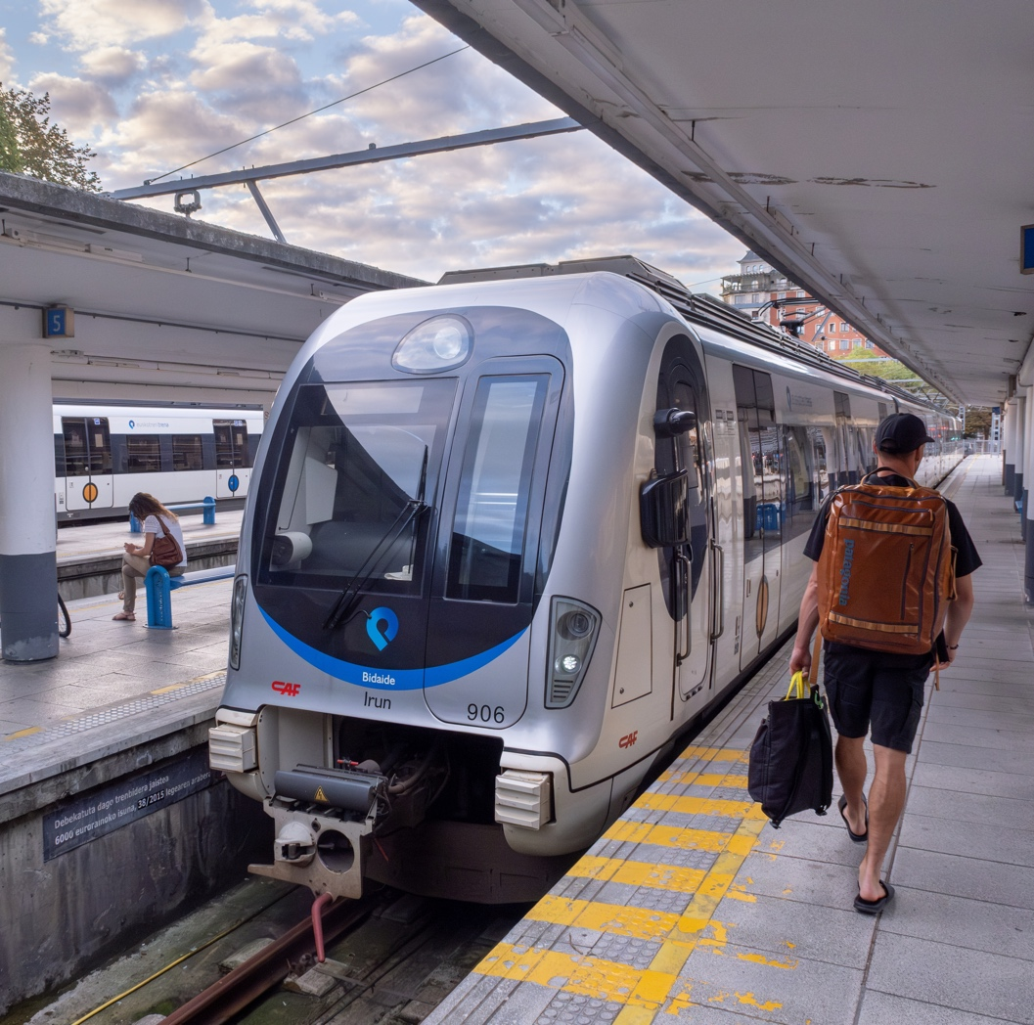
TALKING ABOUT YOUR HOLIDAY
ROLE-PLAYING A TRIP CONVERSATION
Scenario: You are at a train station, and you need to ask for information about your trip.
Pair Activity:
One student plays the role of a passenger, and the other plays the role of a station employee.
Use these key phrases:
"Excuse me, where is the platform for the 10 AM train?"
"How long does the journey take?"
"Can I buy a ticket here?"
Instructions:
Practice the conversation with your partner.
Switch roles and practice again.
Present your conversation to the class.

Slide 8
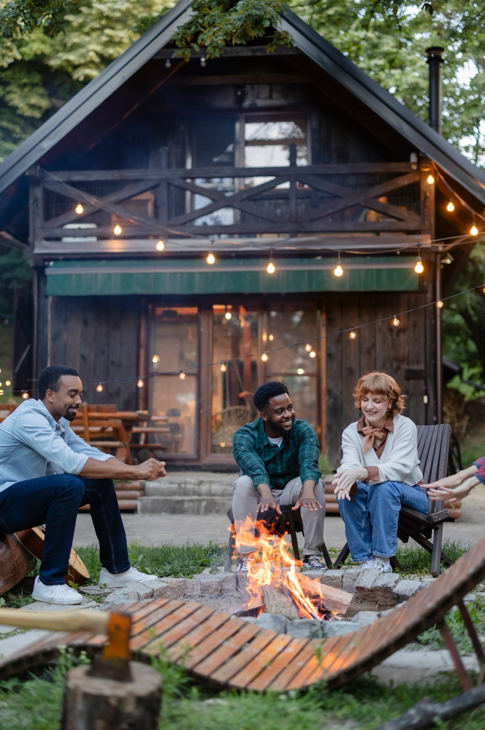
TALKING ABOUT YOUR HOLIDAY
DESCRIBING A TRAVEL EXPERIENCE
Activity:
Students describe a past trip using the following structure:
Where did you go?
How did you get there?
Who did you go with?
What did you do?
What was the best part of the trip?
Example Answer:
"Last summer, I went to the mountains with my family. We traveled by car and stayed in a small cabin. We went hiking every day, and I loved the beautiful scenery. The best part was sitting around the fire at night and telling stories."

Slide 9
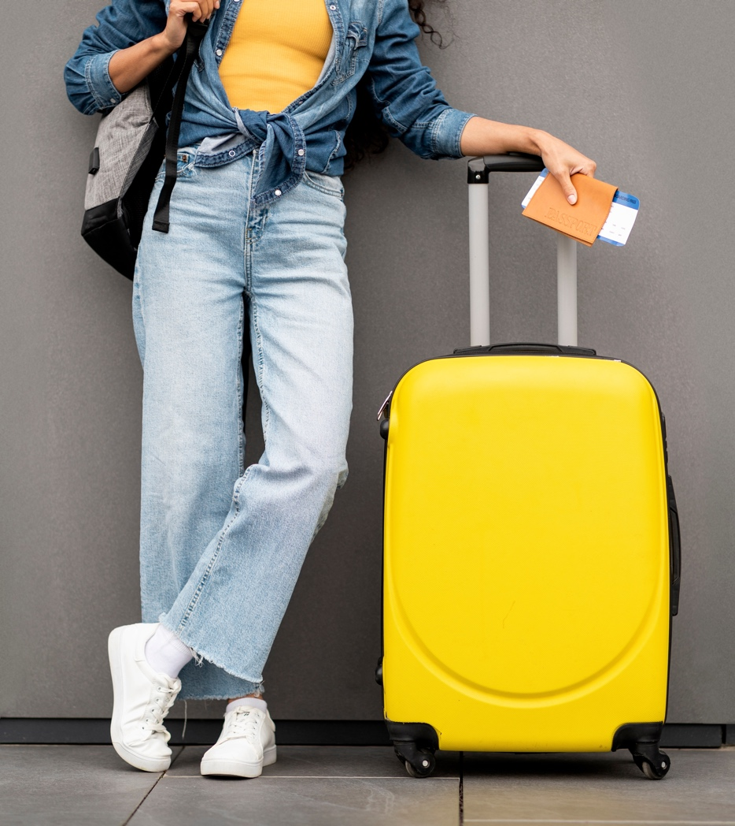
TALKING ABOUT YOUR HOLIDAY
Travel Questions – Auxiliary or Not?
Fill in the blanks using the correct question format:
_______ (Who/What) helped you carry your suitcase?
_______ (Where/How) did you go on your last holiday?
_______ (Who/What) let you borrow a map?
_______ (What/Who) happened during the trip?
_______ (What/Who) do you want to visit next?

Slide 10
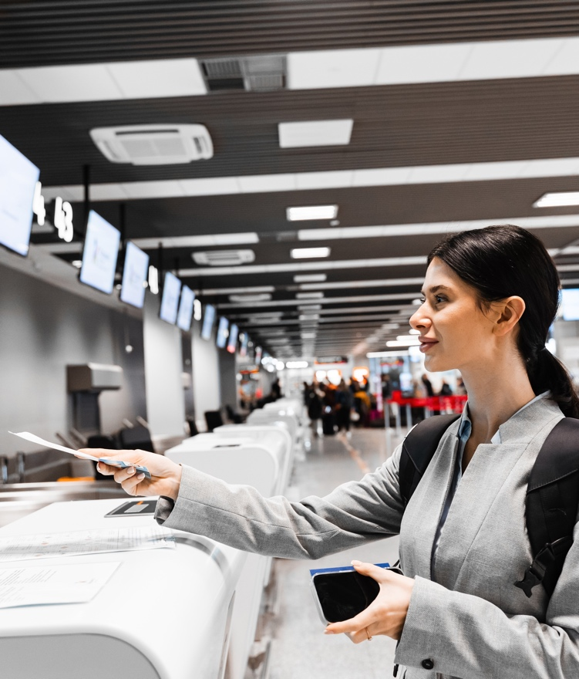
TALKING ABOUT YOUR HOLIDAY
WH- QUESTIONS – TRAVEL EDITION
Instructions: Complete the questions using the correct Wh- question word (Who, What, Where, When, Why, How).
_______ do you usually travel with?
_______ is the best time to visit the beach?
_______ do people love going on vacation?
_______ do you get to the airport from your house?
_______ is your dream travel destination?

Slide 11
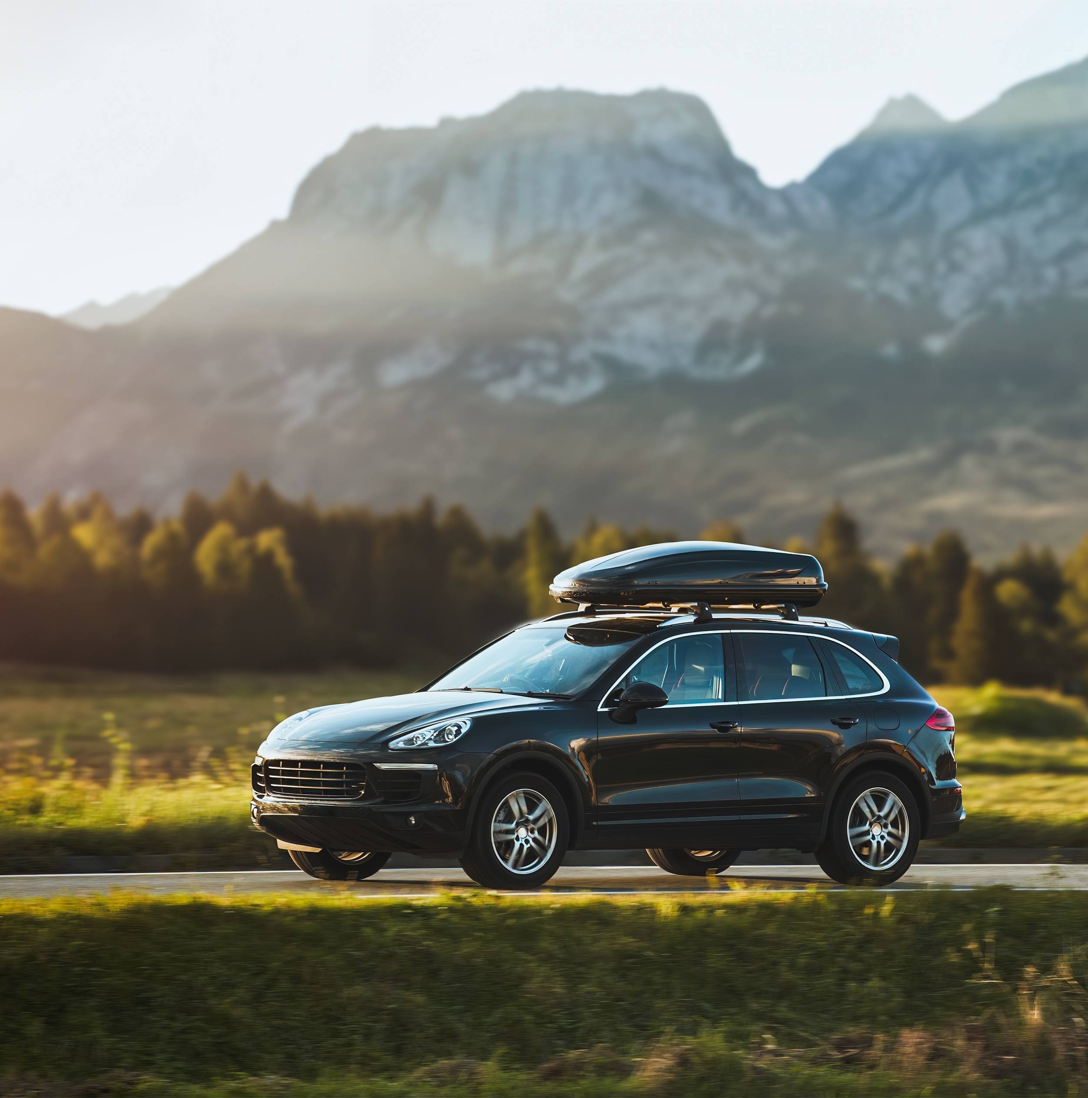
TALKING ABOUT YOUR HOLIDAY
LET’S CHECK!
Quick Check Questions:
What are three things you need for a trip?
What is the difference between “journey” and “stay”?
How do you ask for travel information at a train station?
What was your favorite activity from today’s class?

